Slide 1
The Immune System
PowerPoint by Jody Baker and Joseph Parrish
Artwork by Alysa Chirillo and Ryan Williams

Slide 2
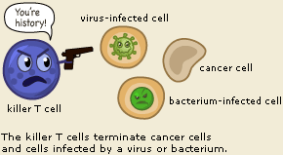
Overall Function
The overall function off the immune system is to fight off any foreign pathogens that come in contact with the body.
This system is also responsible for remembering any disease that causes a major issue and enforcing preventative measures

Slide 3
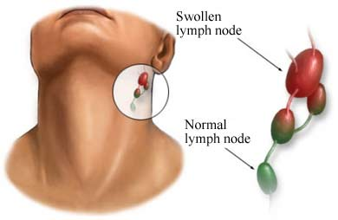
Main Organs
Lymph Nodes and Channels – The individual system in the body for the transportation of lymphocytes, or white blood cells as well as lymph, which is a clear fluid that contains wastes out of the body
Spleen – Filters the blood for irregularities, fights infections, recycles dead or unused cells, and keeps your body fluids in balance
Thymus – transforms lymphocytes into T-cells
Skin – serves as a barrier from the outside world and aids temperature regulation

Slide 4
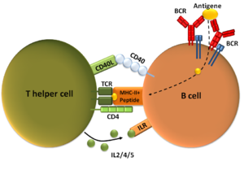
Types of Cells
B-Cells – b cells secrete antibodies that tag foreign pathogens for T cells to eat
T-Cells- t cells defend the body by either directing other defenses, or directly attack infected cells
Phagocytes – phagocytes ingest foreign pathogens to get rid of them so they do not infect the body

Slide 5
Effects of Diseases
Diabetes – due to poor circulation, diabetics are prone to various infections because the immune system does not receive the nutrients it needs
Sickle Cell Anemia – the same issues as above and an even higher rate of infections due to possible damage to the spleen and thymus
Heart Disease – any part of the immune system could be damaged, resulting in many possible issues, like poorly filtered blood cells and a weakened immune system in general
Urinary Tract Infection – increased inflammation as the immune system attempts to fight the infection, increased chance of the other infections as the immune system responds to the one particular disease and is already under siege, a chance of increased fatigue as the body attempts to respond by increasing lymphocyte production
The catheter also caused a heightened immune response as well as the hospital environment

Slide 6
Sources
http://www.niaid.nih.gov/topics/immuneSystem/Pages/whatIsImmuneSystem.aspx
http://www.news-medical.net/health/Structure-and-function-of-lymph-nodes.aspx
http://www.nlm.nih.gov/medlineplus/spleendiseases.html
http://www.chp.edu/CHP/organs+spleen+functions
http://www.healthguidance.org/entry/9164/1/The-Skin-Functions-of-the-Skin.html
http://www.niaid.nih.gov/topics/immuneSystem/immuneCells/Pages/bcells.aspx
http://www.nobelprize.org/educational/medicine/immunity//immune-detail.html

