Slide 1
Glucometer 2000
PowerPoint by Joseph Parrish, Alysa Chirillo, Ryan Williams, and Jody Baker

Slide 2
Our Idea
New diabetic testing and management device
Features
Touch Screen
Fully Computerized
An individual device
More features than is common for these devices
Easily accessible
Rechargeable
Contains everything a diabetic needs, save their medication
Optional Bluetooth

Slide 3
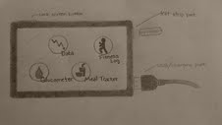
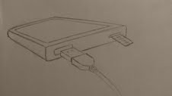
Sketch

Slide 4
Specific Features
A food/meal guide and recorder
Customizable alarms and calendar
Easy access to graphs and charts that can be viewed on a computer or emailed
Wireless or wired connection to a insulin pump
Charts guiding your diet
A memory and analysis of foods eaten
A method to track exercise and food and its effects on you
A method to recommend an appropriate dosage of insulin or glucose

Slide 5
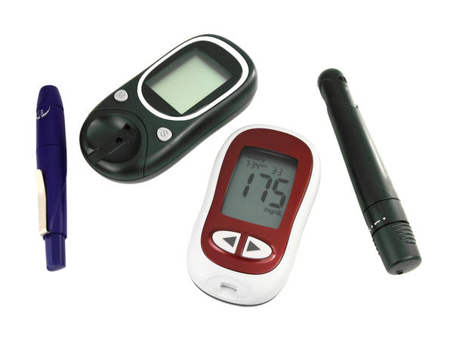
What makes this device different?
Additional features
Ease of access
Clear data
One individual purchase - not pared with another device
Updateable
Analysis of exercise and food

Slide 6
Target Audience and Price Point
Geared towards the younger or middle aged, but easily used without the extra features
Can be set and left unaltered
More expensive than your average glucometer, but will most likely be covered by insurance due to extra features

